Slide 1
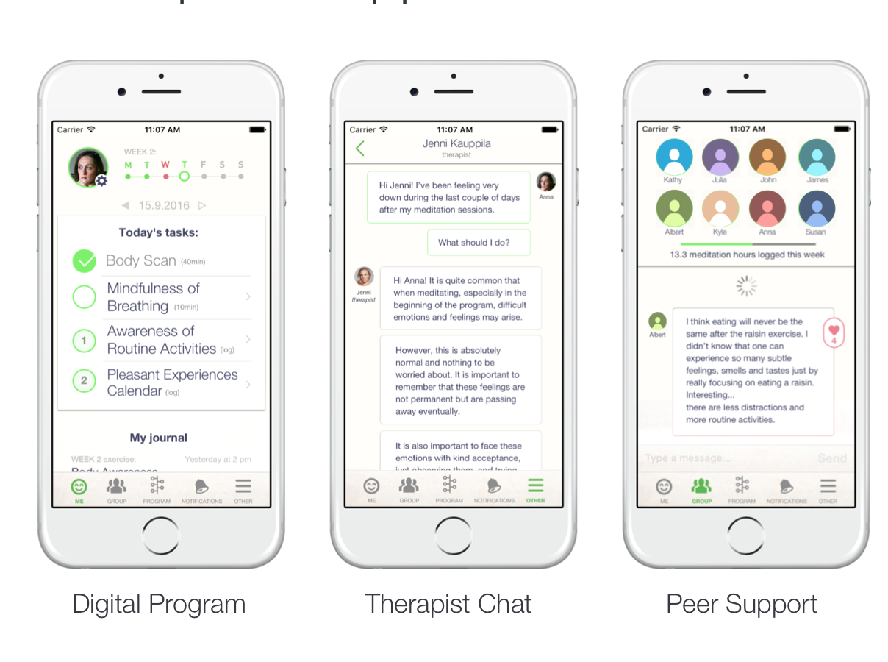
Feasibility Study of the Meru Health Ascend Mobile Application
Intervention in Middle and Older-Aged Adults with Depression
Flora Ma,^{1,2} Chalise Carlson,¹ Riku Lindholm,³ Kristian Ranta,³ Ruth O’Hara,^{1,4} & Christine E. Gould ^{1, 4} ¹VA Palo Alto Health Care System, ²Palo Alto University, ³Meru Health, ⁴Stanford University School of Medicine
Introduction
INTRODUCTION
RESULTS
QUALITATIVE ANALYSIS (POST-TREATMENT)
Studies largely conducted with younger adults demonstrate that guided mobile app interventions were superior in reducing mental health symptoms (e.g., depressive symptoms) compared to non-guided interventions (1,2).
Despite advantages of technology to manage mental health symptoms, it is not known whether these interventions are acceptable to older individuals.
The current study addresses this question by examining the acceptability and satisfaction of the Meru Health Ascend Program in middle to older-aged adults with depressive symptoms.
Satisfaction with the Program
Completely met my expectations 50% | Somewhat met my expectations 30% | Somewhat did not meet my expectations 10% | Did not meet my expectations at all 10%
Introduction
IMPLICATIONS
Introduction
IMPLICATIONS
BENEFITS
Provide hope
Develop patience
Encourage physical activities
Remain calm in stressful situations
Encouragement for self care
Helpful Components
Practices
Daily Goal Setting
Video Lectures
Availability of a therapist
Group/Peer Support
The Meru Health Ascend Program is an 8-week mobile app for depressive symptoms. During the 8 weeks, participants are placed in an anonymous group within the app. Participants individually learn about mental health and engage in guided mindfulness practices. Participants have access via within-app messaging to a therapist as well.
Introduction
56 Screened
18 Consented
9 Completed the Program
1 Dropped out
8 Ongoing in Program
Technology Challenges and Desired Features
Problems with app (i.e. closing)
Compatibility with tablet
Speak-to-text
Voice Option
Program Improvements
Therapist check-ins 2x week
Orientation to Program
Clearer instructions
Increase personalized interactions
METHODS
Demographics
Mean Age: 61.89
(SD = 11.92)
66.7%
33.3%
Introduction
Female
Male
Interested participants were screened over the telephone to assess eligibility.
Ethic/Racial Background
CONCLUSION
$66k
$161,280
Our findings suggest that the Meru Health Ascend Program is acceptable to middle aged and older adults based on low drop-out (10%) and high satisfaction (80% met some or all expectations).
Qualitative data highlight numerous perceived benefits of program ranging from emotional to functional improvements.
Possible improvements to the program for middle aged and older users would be providing access to the program on a larger device (i.e., tablet) or with flexible text inputting options.
Next steps will be to examine whether participants achieved clinically meaningful improvement on the PHQ-9 measure after program participation.
Inclusion Criteria
Participants aged 40 years or older
Have a mobile device
Lived in California
Had moderate depressive symptoms PHQ-9 ≥ 10
Exclusion Criteria
Participants with cognitive impairments, frequent alcohol use, and psychotic symptoms
Concurrent psychotherapy or not on stable dose of psychotropic medication
Active suicide ideation with intent and/or plan
Clinical Diagnosis
33% co-morbid
Anxiety Diagnosis
Participants were scheduled for an in-person clinical interview and completed depression measures, anxiety measures, Mini International Neuropsychiatric Interview (M.I.N.I.-7), and the Mobile Device Proficiency Questionnaire (MDPQ) at baseline.
Introduction
REFERENCES
1. Ahern, E., Kinsella, S., & Semkovska, M. (2018). Clinical efficacy and economic evaluation of online cognitive behavioral therapy for major depressive disorder: A systematic review and meta-analysis. Expert Review of Pharmacoeconomics & Outcomes Research, 18(1), 25-41.
Week 4 Assessments
2. Mohr, D. C., Cuijpers, P., & Lehman, K. (2011). Supportive accountability: A model for providing human support
to enhance adherence to eHealth interventions. Journal of medical Internet research, 13(1).
Introduction
Baseline Measures
Flora Ma: fma@paloaltou.edu
Week 8 included post-treatment qualitative interview, depression measures, and anxiety measures.
Mean (SD) PHQ-9 | Mean (SD) MDPQ
12.94 (3.83) | 202.35 (24.31)
Funding: This study is supported by Meru Health. ClinicalTrials.gov Identifier: NCT03652948.
Acknowledgements: This work was supported by a Career Development Award (IK2 RX001478; PI: Gould) from the United States (U.S.) Department of Veterans Affairs Rehabilitation Research and Development Service. Views expressed in this poster are those of the authors and not necessarily those of the Department of Veterans Affairs or the Federal Government.
Introduction

